Slide 1

Tutorial on IQM Tools Pro
General Dataset Specification and PMX Workflows
Integrated Solutions for Quantitative Drug Development
From Mechanistic Models to Complex Trial Simulation
Henning Schmidt, IntiQuan GmbH
4

Slide 2
Tutorial Outline
General introduction to the IQM Tools Suite
General introduction PMX Workflow Approaches
General Dataset Specification
Hands on PopPK Workflow Example (classroom possible)
Hands on PopPK+PD Workflow Example (self study only)

Slide 3
Tutorial Info
In large parts you will have the opportunity to get hands-on-experience
>> installIQMtoolsInitial
Commands shown in these boxes should be entered on the MATLAB
command line, during the tutorial
********** MODEL NAME
Simple model
********** MODEL STATES
d/dt(Ad)= -ka*Ad + INPUT1
d/dt(Ac)= ka*Ad – CL/Vc*Ac
********** MODEL PARAMETERS
ka = 0.2
CL = 0.3
Vc = 6
********** MODEL VARIABLES
Cc = Ac/Vc
Text shown in these boxes should
be entered where appropriate
(will become clear later)

Slide 4
Tutorial Goal: „You should be able to“
Understand the idea and power of PMX Workflow approaches
Specify a general dataset format for your own projects
Perform a PopPK using the IQM Tool PopPK Workflow
Perform a PopPKPD using IQM Tools

Slide 5
Tutorial Outline
General introduction to the IQM Tools Suite
General introduction PMX Workflow Approaches
General Dataset Specification
Hands on PopPK Workflow Example (classroom possible)
Hands on PopPK+PD Workflow Example (self study only)

Slide 6
Introduction to the “IQM Tools Suite”
The IQM Tools Suite is provided freely and as open source
The IQM Tools Suite consists of two main packages
  IQM Tools Lite
  IQM Tools Pro
The whole is based on MATLAB (www.mathworks.com)
IQM Tools Lite
Model, experiment, measurement & dosing representation, simulation, analysis functions, optimization, signal processing, statistical functions, etc.
IQM Tools Pro
Systems biology/pharmacology and PMX functionality, clinical data analysis, nonlinear mixed effect modeling, clinical trial simulations, high speed simulation through transparent C-code interface

Slide 7
Modular Design of the IQM Tools Suite
MONOLIX
NONMEM
IQM Tools Pro (pmx) (population PKPD, workflows, trial simulation, ...)
IQM Tools Pro
(sys)
(parameter
determination
functionality)
GUI Functions
(Model editing, visualization, etc.)
IQM Tools Lite
Functions
(Analysis, Simulation, etc.)
Optimization
Algorithms
SUNDIALS
CVODES
Powerful
Solvers
Low-Level Functions
(creating, converting objects)
Signal Processing
functions
Statistical
functions
IQMprojectSB
IQMmodel / IQMmeasurement
IQMexperiment/IQMdosing
SBML
Toolbox
MEX
MATLAB
ODE FILE
..., ..., ...

Slide 8
Requirements
MATLAB R2013b (or later)
  Optional but very useful: Parallel Toolbox to allow for better runtimes of the examples
Required 3rd party software
  Monolix Version 4.2.3 (or later) (http://www.lixoft.org)
  NONMEM Version 7.2 (or later) (http://www.iconplc.com)
  The tutorial uses both. If only one of them is installed, then this is fine, but the tutorial scripts might need to be changed accordingly – and if MONOLIX was used on purpose due to numerical issues with NONMEM – then using NONMEM might not produce the adequate result.

Slide 9

Where to get IQM Tool Suite from?
Free download of IQM Tools Suite available from the IntiQuan webpage
The IQM Tools Suite is distributed as a ZIP file with both IQM Tools Lite and IQM Tools Pro included
Unzip this ZIP file on your computer at a location where you want to store the IQM Tools
www.intiquan.com

Slide 10
How to Install the IQM Tool Suite?
Start MATLAB
Change into the “IQM Tools Suite” folder
Read and update custom information in setup files:
  IQMlite/SETUP_PATHS_TOOLS_IQMLITE.m
  IQMpro/SETUP_PATHS_TOOLS_IQMPRO.m
Execute the “installIQMtoolsInitial” script
You need to execute the “installIQMtoolsInitial” script once after obtaining a copy of IQM Tools. This will compile required libraries.
After this first installation, you can use the function “installIQMtools” to install IQM tools. This needs to be done each time you exit and start MATLAB again. This is on purpose for compliance and reproducibility reasons.
If you do not care about compliance, you might want to consider the use of a startup.m script (see http://www.mathworks.com/help/matlab/ref/startup.html).

Slide 11
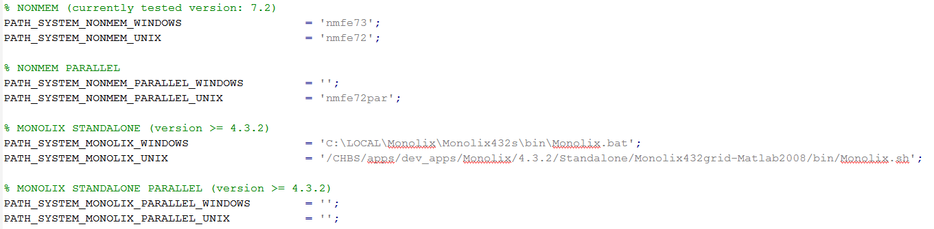
Installation of optional 3rd party software
Please follow the providers instructions when installing optional 3rd party software.
  Update the IQMpro/SETUP_PATHS_TOOLS_IQMPRO.m file with the relevant information, as shown below for an example implementation

Slide 12
IQM Tools’ Documentation
  MATLAB style help
IQM Tools Tutorials with examples
  Part 1: IQM Tools Lite (General Model Specification, Simulation, etc.)
  Part 2: IQM Tools Pro (MEX / Systems Biology/Pharmacology Projects)
  Part 3: IQM Tools Pro (Basic Pharmacometrics)
  Part 4: IQM Tools Pro (General Dataset Specification and PMX Workflows)
  Part 5: IQM Tools Pro (Advanced Clinical Trial Simulations)
  Part 6: IQM Tools Pro (Linking Systems Pharmacology Models to Clinical Data)
  IQM Tools – Workshops
    Given on demand and on some conferences during a year
>> help IQMlite
>> help IQMpro
>> help IQMsimulate
>> help IQMexportCSVdataset
>> doc IQMlite
>> doc IQMsimulate

Slide 13
Tutorial Outline
General introduction to the IQM Tools Suite
General introduction PMX Workflow Approaches
General Dataset Specification
Hands on PopPK Workflow Example (classroom possible)
Hands on PopPK+PD Workflow Example (self study only)

Slide 14
Workflow
„A workflow consists of an orchestrated and repeatable pattern of business activity enabled by the systematic organization of resources into processes that transform materials, provide services, or process information. It can be depicted as a sequence of operations, declared as work of a person or group, an organization of staff, or one or more simple or complex mechanisms.”
Applicable to Pharmacometric modeling?
https://en.wikipedia.org/wiki/Workflow

Slide 15
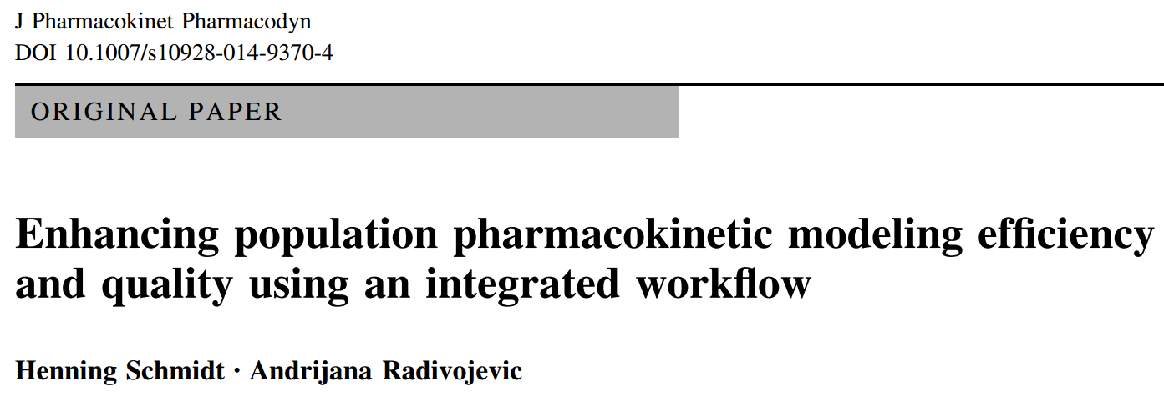
Discussion and application of a workflow approach to Population PK modeling
http://web.intiquan.com/Material/PopPK_Workflow/schmidt_radivojevic_2014.pdf

Slide 16
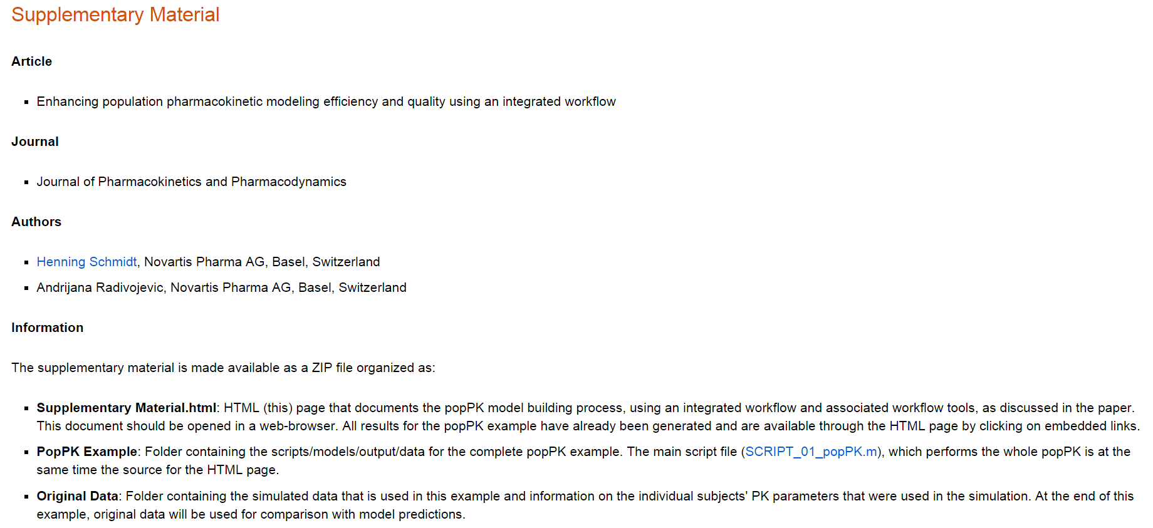
Fully Documented Example for a PopPK Workflow
Performed with SBPOP – Supplementary to the paper
http://web.intiquan.com/Material/PopPK_Workflow/index.html
Enhancing population pharmacokinetic modeling efficiency and quality using an integrated workflow, Journal of Pharmacokinetics and Pharmacodynamics, doi:10.1007/s10928-014-9370-4, 2014.

Slide 17
What does a Workflow Approach bring?
Structure
Systematic analysis
Consistent quality across an organization
Less inter-modeler variability and thus in average higher quality
Workflow approaches are applicable on small scale
  General dataset specification => Data Checking, Data Exploration, Data Conversion
  NLME model generation, run, creation of typical GoF plots and tables
  Etc.
Workflow approaches are applicable on larger scale
  Generation of a model subspace of interest
  Running all these models (including creation of GoF plots, etc.)

Slide 18
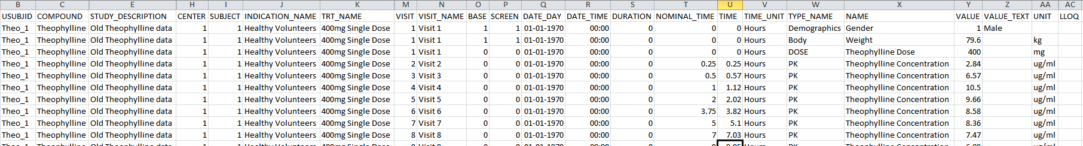
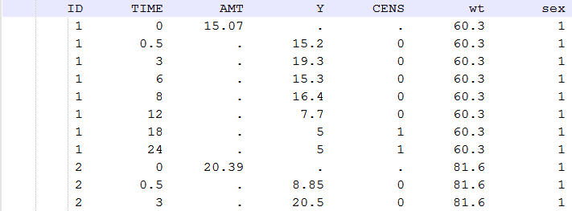
Data => Generalized standard dataset format
Imagine you could represent all the clinically relevant data in a humanly understandable and reusable (for many different purposes) form
That is independent of a single person
That is independent of a single analysis
That does not require cumbersome manual reformatting
Self explaining content, informative, useful
???
But typical PMX dataset

Slide 19
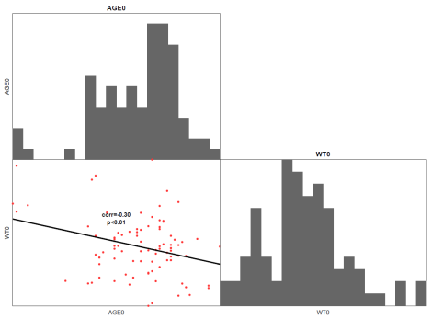
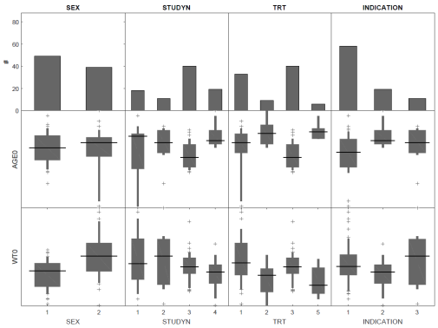
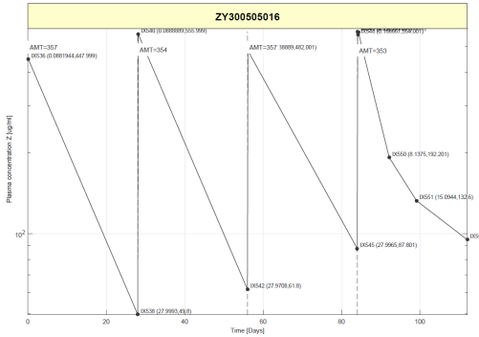
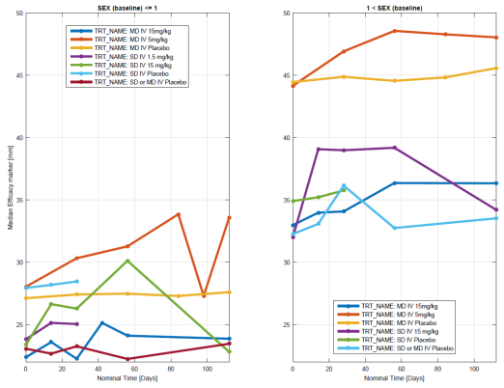
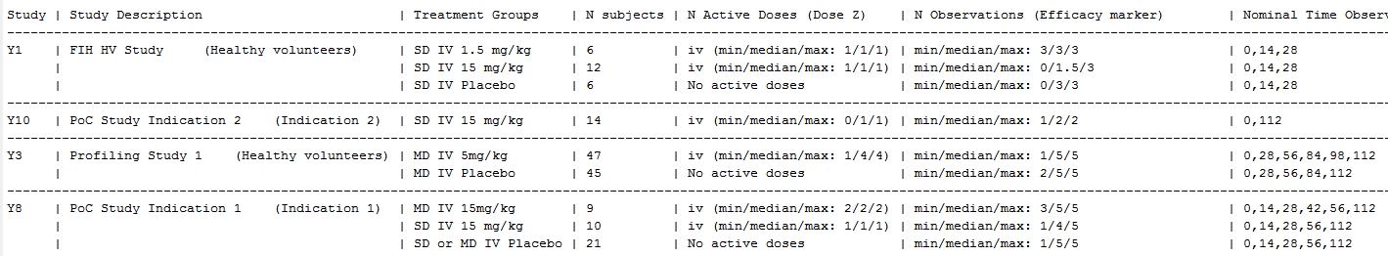
Data Exploration
Imagine you could quickly explore your PK and PD data by generation of the typical plots that everyone always would like to see (but might forget about it)
Imagine axes labels would already have the correct names and units
Imagine you could prepare tables that need to be shown in all modeling reports, just from the general dataset format

Slide 20
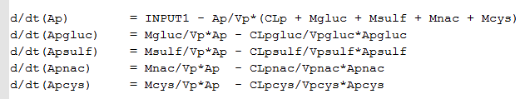
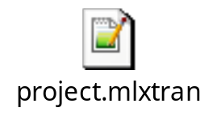
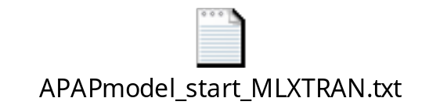
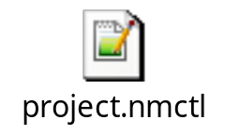
General (population) modeling
Imagine you could simply convert your desired mathematical model into the NLME software of your choice
Imagine you could automatically prepare your NLME modeling dataset from the standard dataset and use this across different NLME modeling tools (NONMEM and MONOLIX)

Slide 21
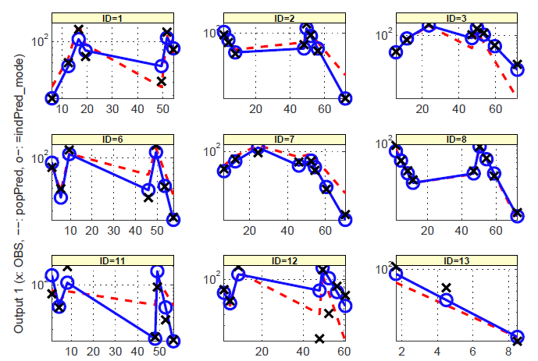
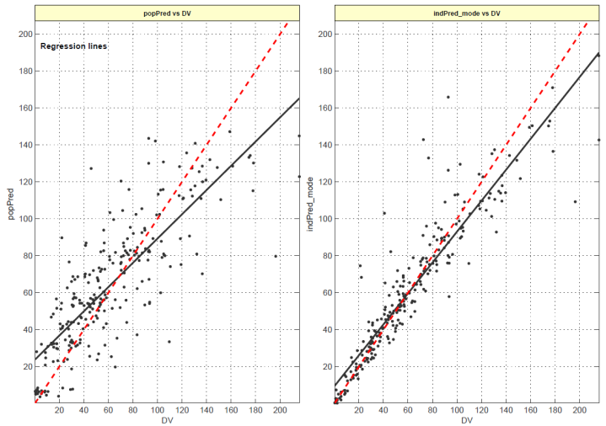
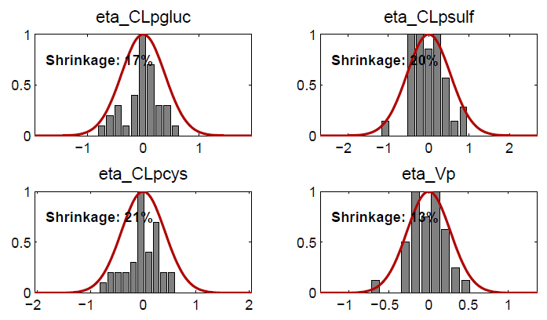
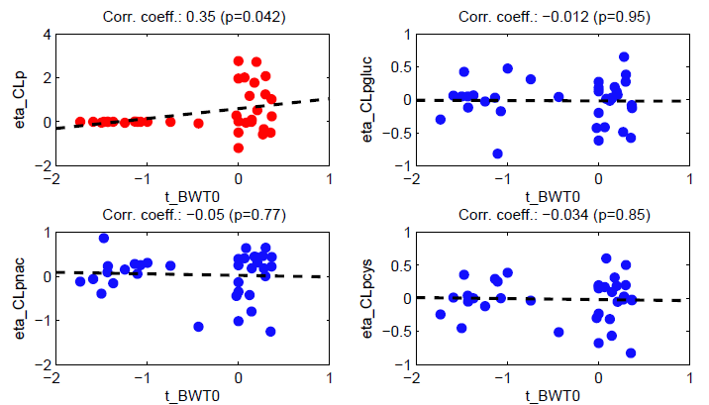
General (population) modeling
Imagine each run of a model would immediately also produce the standard goodness of fit assessments, enabling you to quickly assess the model

Slide 22
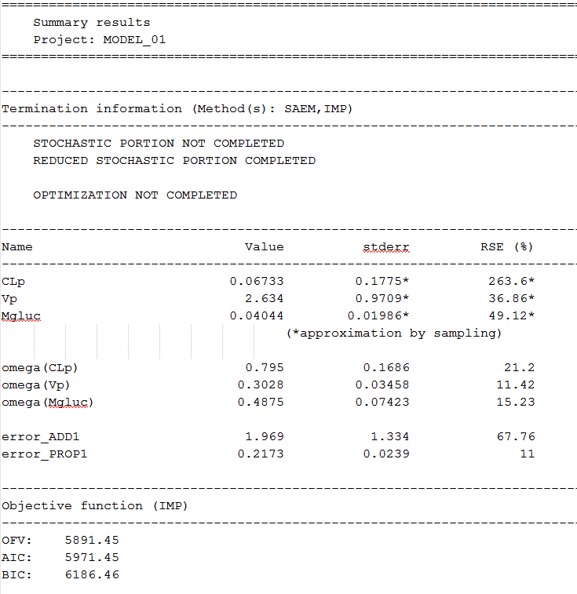
General (population) modeling
Imagine the output of NONMEM would be transformed to something that is humanly readable and contains the same information as the MONOLIX output
Imagine you could just focus on the right model, rather than on cumbersome data and tool issues ...

Slide 23
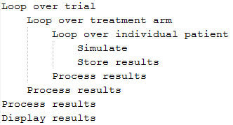
General clinical trial simulation
Imagine you would not need to recode your model in Berkeley Madonna or other software for simulation
Imagine you would NOT need to create cumbersome datasets for simulation
Imagine you could sample population parameters and/or individual parameters (with or without covariate effects) directly from MONOLIX and NONMEM projects
Imagine even VERY complex clinical trial simulations are just a couple of for-loops away

Slide 24
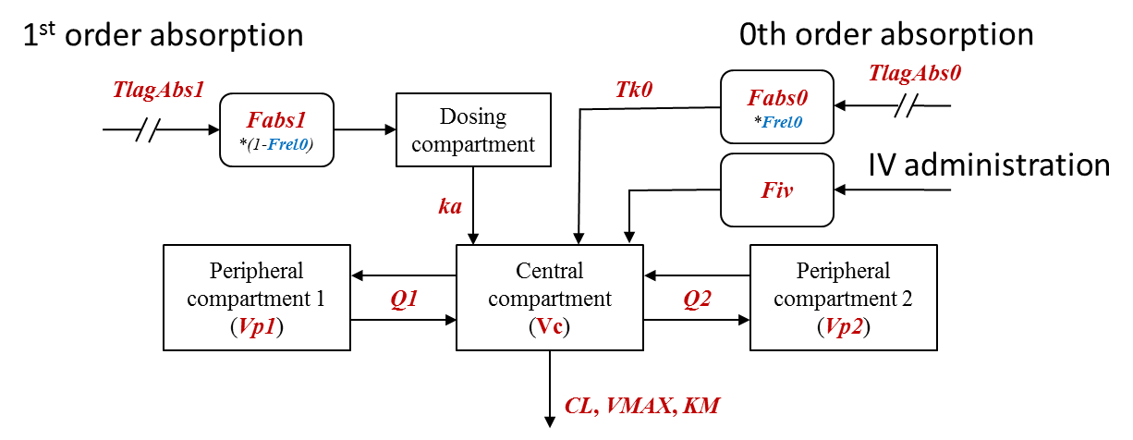
Workflow approach to popPK modeling
An internal review at Novartis revealed that >85% of all generated popPK models can be represented by the following „general popPK model structure“:
And this structure is likely to support >95% of all clinically relevant questions with respect to the dose/concentration relationship

Slide 25
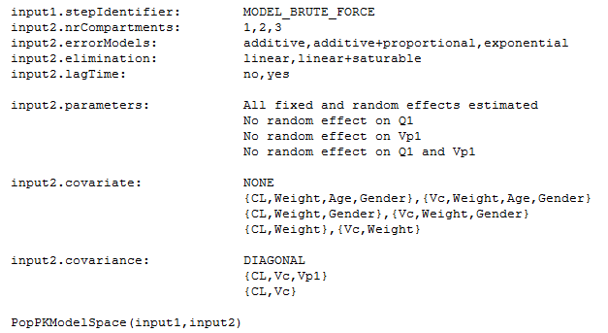
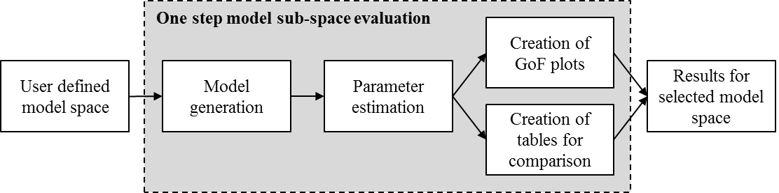
PopPK modeling workflow
Imagine you only need to describe the models that you are interested in evaluating and the workflow tools would do the rest

Slide 26
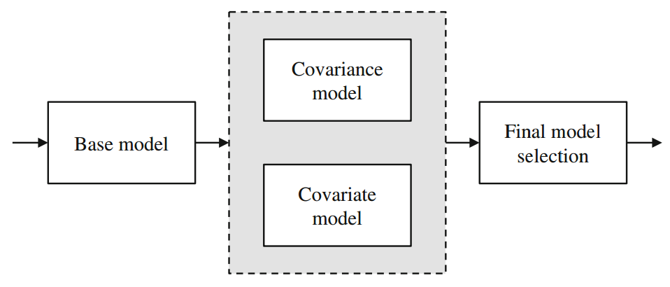
PopPK modeling workflow
Imagine a structure popPK workflow template supports you in doing the typical activities during popPK model building
Imagine the typical analyses are just a click away
  Stepwise covariate search
  Bootstrap
  VPC
  Etc.
You then could focus on the „science of modeling“
and „providing timely input for decision making“
rather than on the „art of working around tool issues“

Slide 27
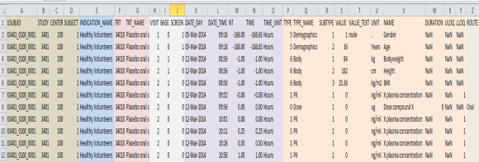
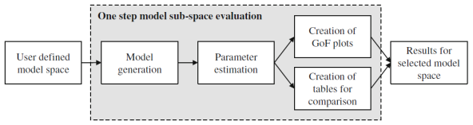
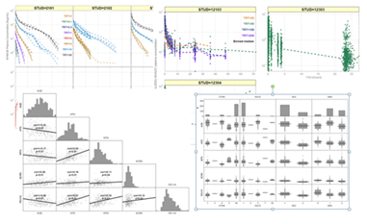
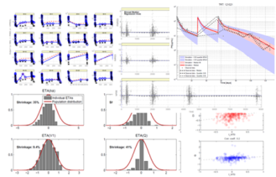
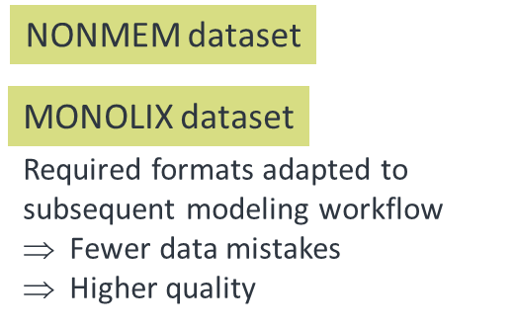
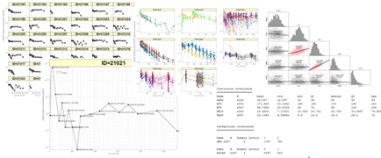
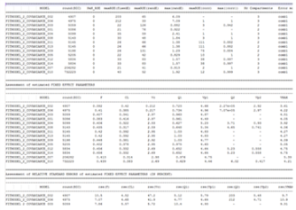
PopPK modeling workflow:
From data standards to standard outputs
Standard dataset format covering all pharmacometric analyses
Automatic generation of models of interest and GoF assessments, etc.
Automatic generation of typical data exploratory analyses
Automatic checking of dataset integrity
Fewer iterations, higher quality
New associates get up-to-speed quicker
Less mistakes
Faster turn-around of analyses
Higher and more consistent quality

Slide 28
Summary
Customizable workflow approaches allow to perform similar analyses in the same manner, leading to more consistent results across individual modelers and higher quality
General modeling tools, used in the workflow approaches, allow to step-out of workflow approaches at any point in time and do model and modeling customizations as desired
Good tools and workflow approaches allow to structure data, models, outputs and scripts in a humanly understandable form that is suitable for peer-review, validation, transition to another person

Slide 29
Tutorial Outline
General introduction to the IQM Tools Suite
General introduction PMX Workflow Approaches
General Dataset Specification
Hands on PopPK Workflow Example (classroom possible)
Hands on PopPK+PD Workflow Example (self study only)

Slide 30
General standard dataset
Capturing clinically relevant information
Reuse of the data for many purposes (across line functions – DMPK, PMX, STATS)
Collection of data in databases
Efficient data preparation
Efficient data checking => higher quality data
Efficient standard analyses
Easy integration in workflow approaches

Slide 31

General standard dataset – is it feasible?
It is not only feasible – it is absolutely necessary!

Slide 32
Documentation of General Standard Dataset used in IQM Tools
Column Name | Type | Description
IXGDF | numeric | Column containing numeric indices for each record (1,2,3,4,5, ...) to allow for matching records in case of post-processing the general dataset format
IGNORE | string | Reason/comment related to exclusion of the sample/observation from the analysis
USUBJID | string | Unique subject identifier
COMPOUND | string | Name of the investigational compound
STUDY | string | Study number
STUDYDES | string | Study description
PART | string | Part of study as defined per protocol (1 if only one part)
EXTENS | numeric | Extension of the core study (0 if not extension, 1 if extension)
CENTER | numeric | Center number
SUBJECT | string | Subject identifier (within a center - typically not unique across whole dataset)
INDNAME | string | Indication name
TRTNAME | string | Name of actual treatment given
TRTNAMER | string | Name of treatment to which individual was randomized
VISIT | numeric | Visit number
VISNAME | string | Visit name
BASE | numeric | Flag indicating assessments at baseline (=0 for non-baseline, =1 for first baseline, =2 for second baseline, etc.)
SCREEN | numeric | Flag indicating assessments at screening (=0 for non-screening, =1 for first screening, =2 for second screening, etc.)

Slide 33
Documentation of General Standard Dataset used in IQM Tools
Column Name | Type | Description
DATEDAY | String | Start date of event ('01-JUL-2015')
DATETIME | string | Start time of event ('09:34')
DURATION | numeric | Duration of event in same time units as TIMEUNIT
NT | numeric | Planned time of event. Based on protocol, in the time unit defined in TIMEUNIT column
TIME | numeric | Actual time of event relative to first administration, in the time unit defined in TIMEUNIT column
TIMEUNIT | string | Unit of all numerical time definitions in the dataset ('hours','days','weeks','minutes')
TYPENAME | string | Unique type of event
NAME | string | Unique name for the event
VALUE | numeric | Value of the event, defined by NAME. E.g., the given dose, the observed PK concentration, or the value of other readouts. The values need to be in the units, defined in the UNIT column. Specific cases: For concomitant medications the dose will be given For BLOQ values, 0 will be used Severity levels for adverse events Should not be populated if VALUE_TEXT is populated
VALUETXT | string | Text version of value (if available and useful). Character value as given in the CRF. Should not be populated if VALUE is populated

Slide 34
Documentation of General Standard Dataset used in IQM Tools
Column Name | Type | Description
UNIT | string | Unit of the value reported in the VALUE column. For same event the same unit has to be used across the dataset.
ULOQ | numeric | Upper limit of quantification of event defined by NAME
LLOQ | numeric | Lower limit of quantification of event defined by NAME
ROUTE | string | Route of administration (iv, subcut, intramuscular, intraarticular, oral, inhaled, topical, rectal)
INTERVAL | numeric | Interval of dosing, if single row should define multiple dosings
NRDOSES | numeric | Number of doses given with the specified interval, if single row should define multiple dosings
COMMENT | string | Additional information for the observation/event
The general dataset format in IQM Tools covers >95% of the typical pharmacometric analyses. It is certainly not complete and perfect, but it is a start in the right direction. An industry wide agreement would be of tremendous interest.

Slide 35
Documentation of General Standard Dataset used in IQM Tools
Optional columns in the IQM Tools General Standard Dataset format
  The general data format might also contain the following columns, which are numeric equivalents to some string columns. If not provided, then these are generated automatically in the post processing steps of the general dataset in IQM Tools
Column Name | Type | Description
IND | numeric | Numeric indication flag (unique for each entry in INDNAME)
STUDYN | numeric | Numeric study flag (unique for each entry in STUDY)
TRT | numeric | Numeric actual treatment flag (unique for each entry in TRTNAME)
TRTR | numeric | Numeric randomized treatment flag (unique for each entry in TRTNAMER)

Slide 36
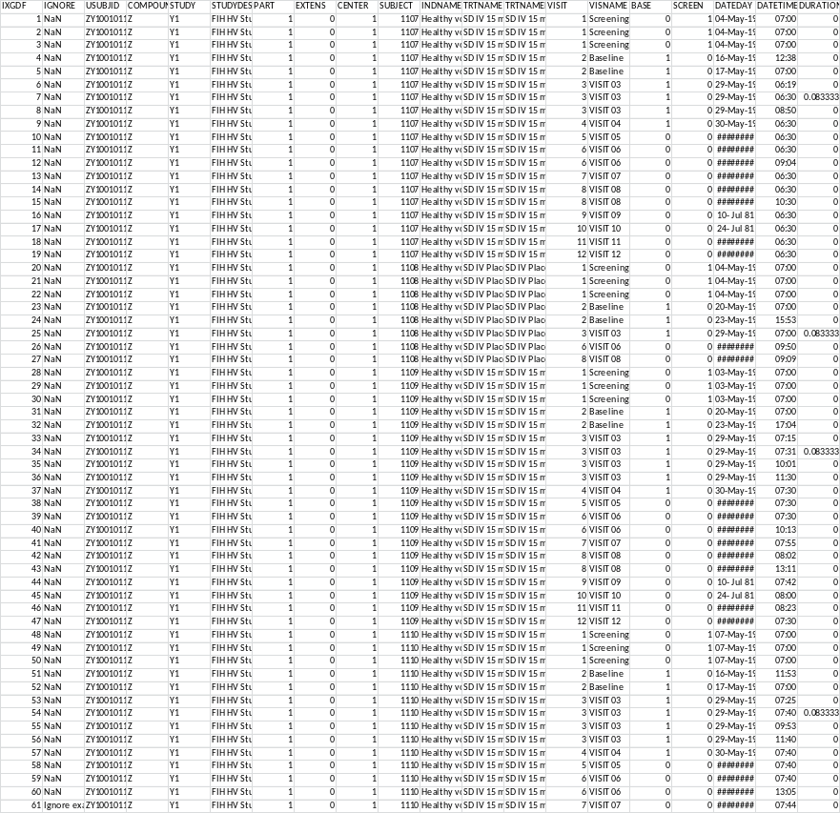
Example for a General Standard Dataset
Provided as CSV file in this PPT
Right-click on the dataset, and there will be some menu point which will allow you to open it in Excel ...
Have a look at it

Slide 37
Tutorial Outline
General introduction to the IQM Tools Suite
General introduction PMX Workflow Approaches
General Dataset Specification
Hands on PopPK Workflow Example (classroom possible)
Hands on PopPK+PD Workflow Example (self study only)

Slide 38

PopPK Hands-On Workflow Example
Change into the Example Files/popPK folder
You will find a complete PopPK Workflow example included
The Data folder contains the example data
in the general standard data format
The Scripts folder contains a single script
that walks you through this example popPK
The script is well documented
Please have a look at the scripts and data ...

Slide 39
PopPK Hands-On Workflow Example
This example uses MONOLIX
The same example is available with NONMEM on request
In a classroom setting it is now time to switch to MATLAB and work through this example together.
In a self study setting – please open MATLAB, change into the Example Files/popPK/Scripts folder, open the script and start reading, executing, etc.
In any case, please change line number 30 in the script to define the location where you have IQM Tools installed
Enjoy!

Slide 40
Tutorial Outline
General introduction to the IQM Tools Suite
General introduction PMX Workflow Approaches
General Dataset Specification
Hands on PopPK Workflow Example (classroom possible)
Hands on PopPK+PD Workflow Example (self study only)

Slide 41
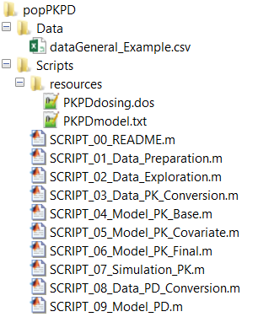
PopPK+PD Hands-On Workflow Example
Change into the Example Files/popPKPD folder
You will find a complete PopPK+PD Workflow example included
The Data folder contains the example data
in the general standard data format
The Scripts folder contains documented analysis
scripts, numerically ordered as they should be
executed
Each script is highly documented
Please have a look at the scripts and data ...

Slide 42
PopPK+PD Hands-On Workflow Example
This example uses MONOLIX and NONMEM – not for the same analyses, but for different purposes (e.g., stepwise covariate search is done using a gradient based method)
This example is nothing for a classroom setting – the runtimes are not excessive but too long for not taking some long breaks inbetween
In self study setting
  Please open MATLAB, change into the Example Files/popPKPD/Scripts folder
  Have a look at each script
  Setup the correct path to IQM Tools in the header section of each script
  Walk through step by step – it is highly documented and for once a pharmacometric analysis and its code is almost self explaining and transparent ;-)
Enjoy!

Slide 43
Tutorial Goal: „You should now be able to“
Understand the idea and power of PMX Workflow approaches
Specify a general dataset format for your own projects
Perform a PopPK using the IQM Tool PopPK Workflow
  Or at least customize the template code to own analyses
Perform a PopPKPD using IQM Tools
  Or at least customize the template code to own analyses

Slide 44
THE END
Thank you for your participation and interest!
The tutorial continues in Part 5 (IQM Tools Pro / Advanced Clinical Trial Simulations)

